Slide 1
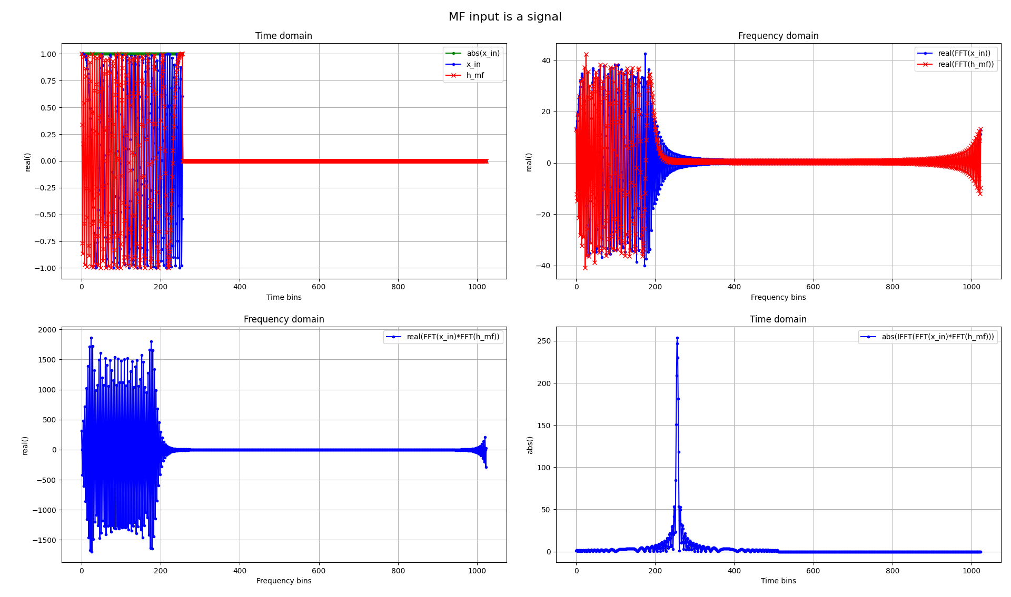
The Advanced Engineering Course
Primary Radar Signal Processing
Theory and Mathematical Model of Matched Filtering in frequency domain
Aleksei Rostov, PhD,
Senior R&D Engineer,
FPGA/Embedded Linux Developer,
aleksei.rostov@protonmail.com

Slide 2
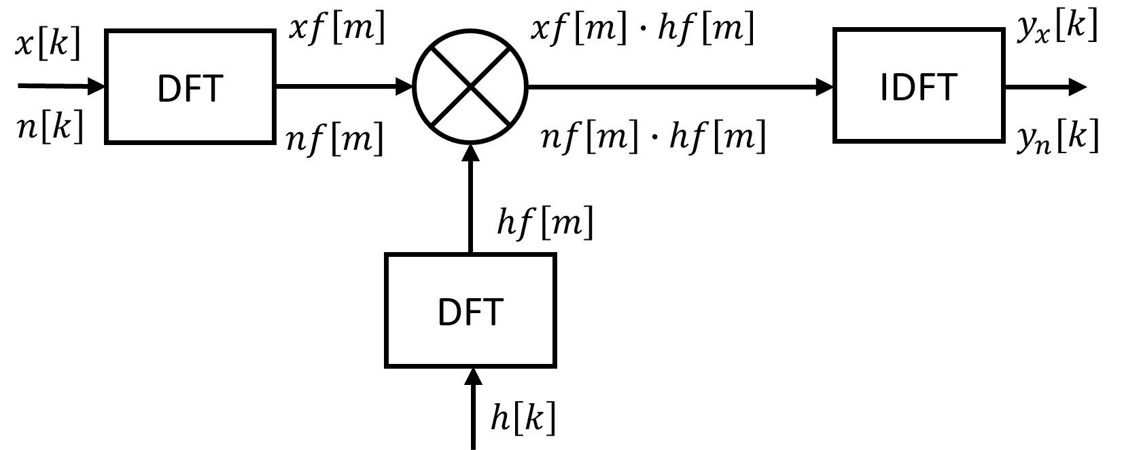
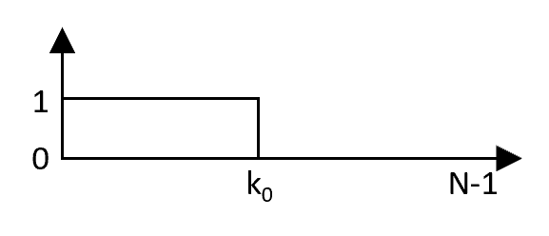

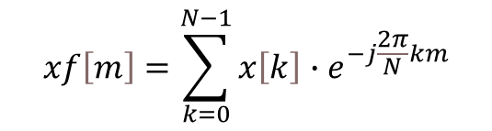
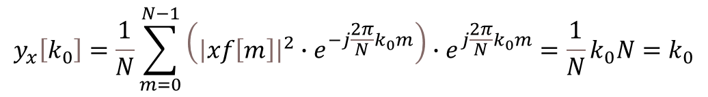
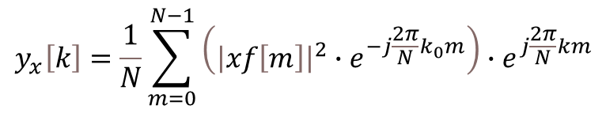


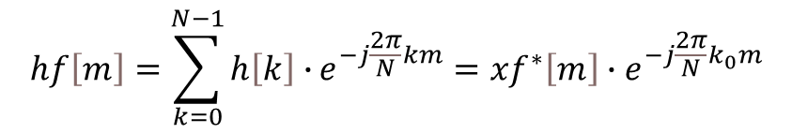
$$x\left[k\right]−input complex pulse signal, k=0…N−1$$
$$n\left[k\right]−input complex white noise$$
$$h\left[k\right]−complex impulse response$$
$$xf\left[m\right]=\sum_{k=0}^{N−1}{x\left[k\right]∙e^{−j\frac{2π}{N}km}}$$
Matched Filtering in frequency domain
$$h\left[k\right]=x\left[k_{0}−k\right]$$
$$hf\left[m\right]=\sum_{k=0}^{N−1}{h\left[k\right]∙}e^{−j\frac{2π}{N}km}={xf}^{∗}\left[m\right]{∙e}^{−j\frac{2π}{N}k_{0}m}$$
$$xf\left[m\right]∙hf\left[m\right]={xf\left[m\right]∙xf}^{∗}\left[m\right]{∙e}^{−j\frac{2π}{N}k_{0}m}={\left|xf\left[m\right]\right|}^{2}{∙e}^{−j\frac{2π}{N}k_{0}m}$$
$$y_{x}\left[k\right]=\frac{1}{N}\sum_{m=0}^{N−1}{\left({\left|xf\left[m\right]\right|}^{2}{∙e}^{−j\frac{2π}{N}k_{0}m}\right){∙e}^{j\frac{2π}{N}km}}$$
$$y_{x}\left[k_{0}\right]=\frac{1}{N}\sum_{m=0}^{N−1}{\left({\left|xf\left[m\right]\right|}^{2}{∙e}^{−j\frac{2π}{N}k_{0}m}\right){∙e}^{j\frac{2π}{N}k_{0}m}}=\frac{1}{N}k_{0}N=k_{0}$$
aleksei.rostov@protonmail.com

